Slide 1

COMPUTER SCIENCE AND ENGINEERING
PROJECT REVIEW
Title: Algorithm Performance Analyzer
Supervisor:
DR. K. Suvarchala
Presented By:
A. KAUSHIK (22951A0569)
B. NYNISHA (22951A05D0)
P. HARSHAVARDHAN (23955A0511)
Project Batch No: 64

Slide 2

INTRODUCTION:
The Algorithm Performance Analyzer (APA) is a cutting-edge tool designed to assist developers, data scientists, and researchers in evaluating and optimizing the performance of algorithms. With a focus on performance analysis, visualization, and optimization recommendations, APA empowers users to make data-driven decisions, resulting in more efficient and effective software solutions. This tool provides detailed insights into time complexity, space complexity, and real-world performance metrics, enabling users to make informed choices about algorithm selection and optimization
Algorithm: An algorithm is a step-by-step procedure or set of rules designed to perform a specific task or solve a particular problem.
The problem statement:
In the field of software development and data science, the choice of algorithm can significantly impact the efficiency and performance of applications. However, developers often lack the tools needed to thoroughly evaluate and compare different algorithms based on real-world and theoretical performance metrics. Existing methods for benchmarking and optimizing algorithms are either too simplistic or fragmented, limiting users’ ability to make informed choices. This project aims to provide a holistic solution that offers detailed performance insights, benchmarks, and optimization recommendations, helping users select the best algorithms for their specific needs.

Slide 3
OBJECTIVE :
Performance Benchmarking: Provide accurate benchmarking capabilities to measure and compare algorithm performance across tasks and datasets.
Complexity Visualization: Offer intuitive visualizations of time and space complexity for various algorithms.
Optimization Recommendations: Suggest optimizations and alternative algorithms based on analysis results.
Real-World Scenario Testing: Enable users to test algorithms under real-world conditions with diverse data inputs and configurations.

Slide 4
EXISTING PRODUCTS:
Algorithm Visualizer: An educational tool for visualizing common algorithms but lacks real-world benchmarking and performance comparison.
Py-Perf (Python): A Python library for performance testing, mainly used for benchmarking but lacks multi-language support and complexity visualization.
Big O Calculator: Offers theoretical complexity calculations, but doesn’t provide real-time benchmarking or visualization.
MATLAB Profiler: A profiling tool built into MATLAB, useful for algorithms and simulations in scientific computing. Provides a detailed breakdown of execution times per function, memory allocations, and even highlights bottlenecks.

Slide 5
DRAWBACKS:
Limited to Specific Languages: Most tools only support one programming language, limiting usability across languages.
Lack of User Guidance: Most tools do not provide adequate tutorials, documentation, or examples to help users understand how to utilize benchmarking and analysis features effectively
No Optimization Suggestions: Few tools provide actionable insights or recommendations for algorithm optimization.
Minimal Custom Reporting: Reporting features are usually basic, limiting detailed data analysis and sharing capabilities.

Slide 6
PROPOSED SYSTEM:
Key Features:
Performance Benchmarking: Compare execution metrics of multiple algorithms on shared datasets across languages (Python, Java, C++).
Complexity Visualization: Intuitive graphs displaying time and space complexity (Big O notation) and algorithm scalability.
Interactive Testing: Real-time performance metrics with adjustable parameters (data size/type).
Optimization Insights: Machine learning-based recommendations for algorithmic improvements.
Custom Reporting: Generate and export detailed performance reports (PDF, CSV).
User-Friendly Interface: Intuitive dashboard with guided tutorials for all skill levels.
Collaborative Features: Share benchmarks and integrate with version control systems (e.g., Git).

Slide 7
PREREQUISITES:
Algorithms and Data Structures: Familiarity with common algorithms (e.g., sorting, searching, graph algorithms).
Programming Knowledge: Experience in at least one programming language, such as Python, Java, or C++.
Data Analysis and Visualization: Understanding of basic data analysis concepts and ability to interpret graphs and performance metrics.
Technologies:
Frontend: HTML, CSS and Bootstrap for an interactive, responsive user interface.
Backend: Java or JavaScript for building robust, scalable backends.
Database: MySQL or PLSQL for efficient data storage.
UI/UX Design: Figma tools for a user-centric interface.
Deployment: AWS or Google Cloud Platform for hosting, with CI/CD tools for automated testing and deployment.

Slide 8
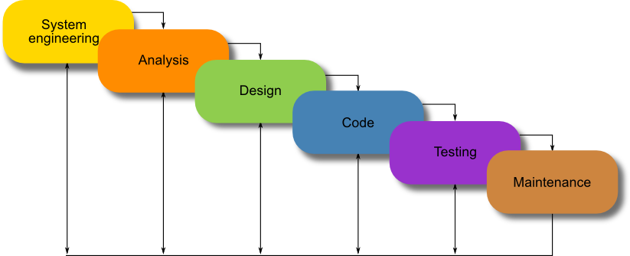
PROJECTS MILESTONES:
Research and Planning: Conduct market analysis, gather user requirements, and define project scope.
➢ Design Phase: UI/UX design and architectural planning for the tool.
Development Phase: Implementation of frontend and backend functionalities, algorithm integrations, and
visualization features.
➢ Testing and Quality Assurance: Comprehensive testing of features and user acceptance testing.

Slide 9
REFERENCES :
[1] Thamilvaani Arvaree Alvar Computing Department, Nilai University College, Negeri Sembilan, Malaysia, “Algorithm analyzer to check the efficiency of codes”, ICIMU : international Conference on Information Technology & Multimedia,2011, [doi:10.1109/ICIMU.2011.6122740]
[2] M. Kuhnemann, T. Rauber, G. Runger, “A source code analyzer for performance prediction” ,
Institute of Electrical and Electronics Engineers,2004 [doi:10.1109/IPDPS.2004] [Medline: 1303333].
[3] Pascal Kerschke, Holger H. Hoos, Frank Neumann, Heike Trautmann, “Automated Algorithm Selection: Survey and Perspectives, MIT Press ,2019-Mar-05 [doi: 10.1162/evco_a_00242]

Slide 10



